Slide 1
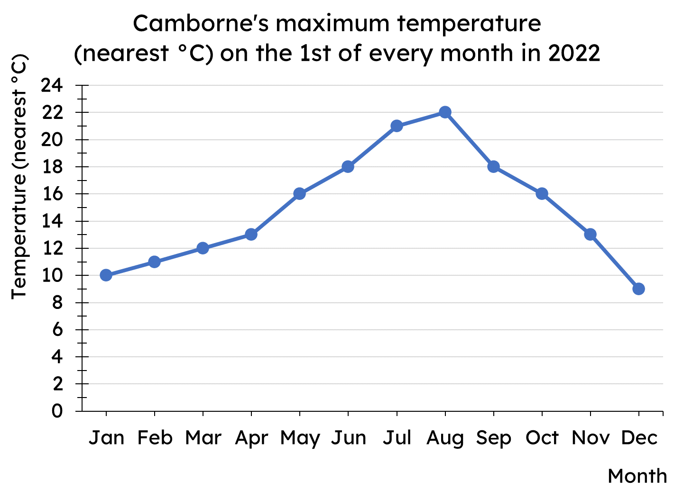
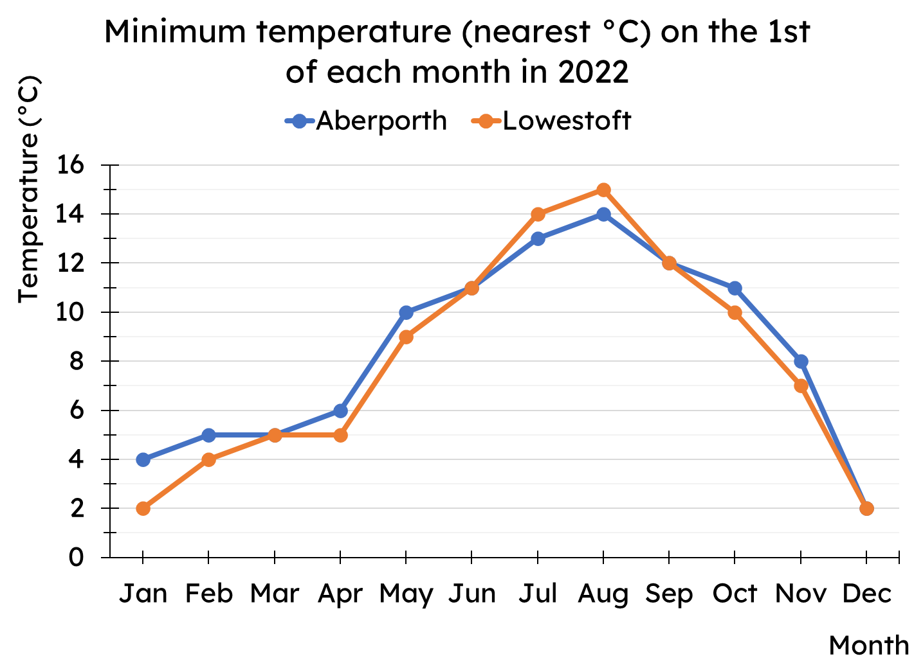
Calculating the mean
Task A: Calculating the mean from a line graph
Use the line graph to complete the table of data.
Jan | 10
Feb | 11
Mar | 12
Apr | 13
May | 16
Jun | 18
Jul | 21
Aug | 22
Sep | 18
Oct | 16
Nov | 13
Dec | 9
Calculate the mean of each data set shown on the line graph.
Aberporth
Total temperature = 101
Mean minimum temperature = 101 ÷ 12 = 8.42 °C (2dp)
Lowestoft
Total temperature = 96
Mean minimum temperature = 96 ÷ 12 = 8 °C

Slide 2
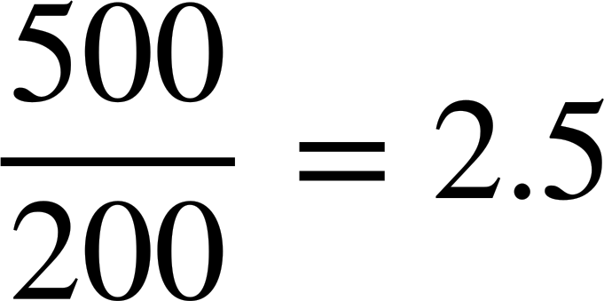

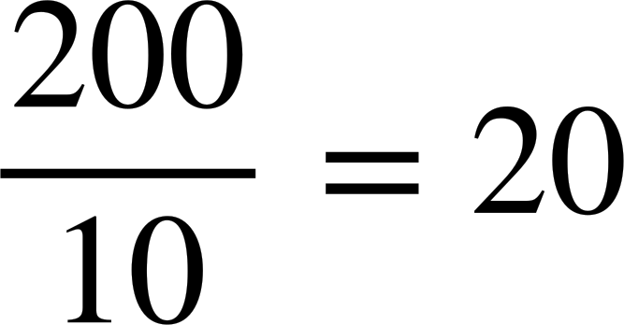
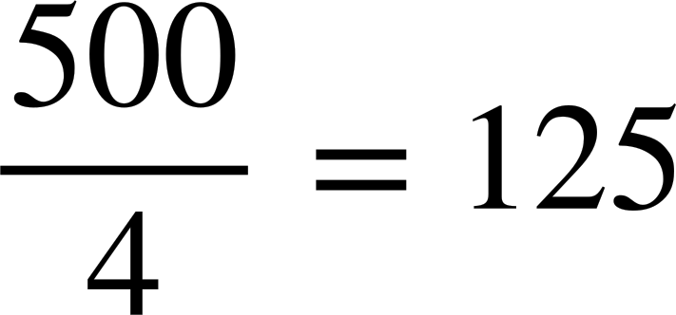
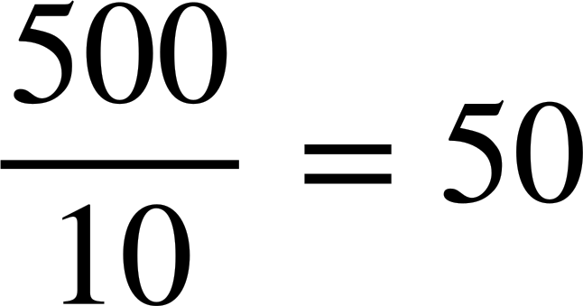
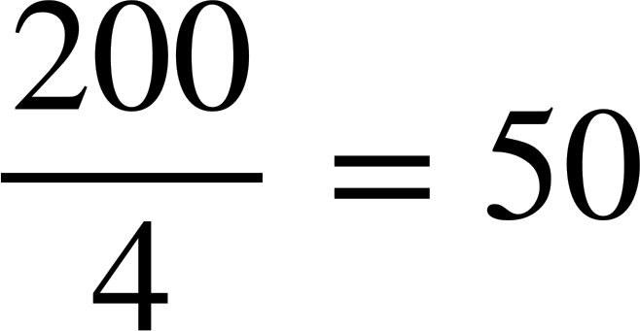
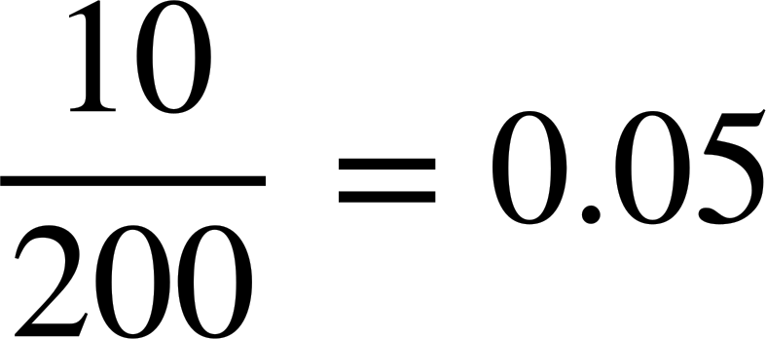
Calculating the mean
Task B: Calculating the mean from an ungrouped frequency table
1) A class take a quiz, marked out of 6. The frequency table shows the results for the class.
Quiz score | 0 | 1 | 2 | 3 | 4 | 5 | 6
Frequency | 3 | 4 | 4 | 7 | 10 | 4 | 1
a) How many pupils are in the class?
b) How many marks did the class get as a group?
c) Hence, what is the mean marks per pupil?
3 + 4 + 4 + 7 + 10 + 4 + 1 = 33 pupils
0 + 4 + 8 + 21 + 40 + 20 + 6 = 99 marks
99 ÷ 33 = 3 marks per pupil
The frequency table shows the number of bedrooms in different houses within an area of a town.
Which calculation correctly finds the mean for this frequency table? For each incorrect answer, why is it wrong?
Bedrooms | Frequency
1 | 20
2 | 93
3 | 54
4 | 33
a)
b)
c)
d)
e)
f)
In b, d and f, the 10 comes from adding up the first column, which is meaningless.
And the 4 in c and e is how many categories, not how many pieces of data.
v2.2

Slide 3
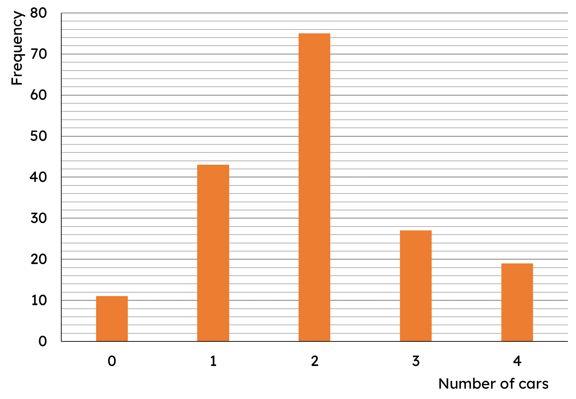
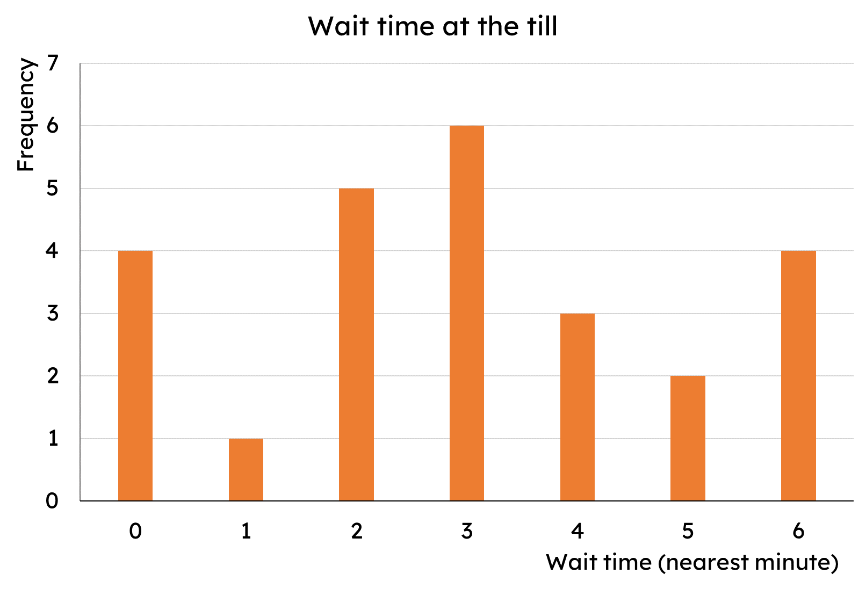
Calculating the mean
Task C: Calculating the mean from a bar chart
This bar chart shows the number of cars per household.
a) How many households are there?
b) How many cars are there in total across all households?
c) What is the mean number of cars per household?
175 households
350 cars
350 ÷ 175 = 2 cars per household
2) The bar chart shows the length of time customers spent waiting at a self-service till (to the nearest minute).
What is the mean wait time?
Total time by all customers
= 0 + 1 + 10 + 18 + 12 + 10 + 24
= 75 minutes
Total customers
= 4 + 1 + 5 + 6 + 3 + 2 + 4
= 25 customers
Mean wait time
= 75 ÷ 25 = 3 minutes
6 lots of 3 minutes
Mathematics in Education and Industry

